Slide 1
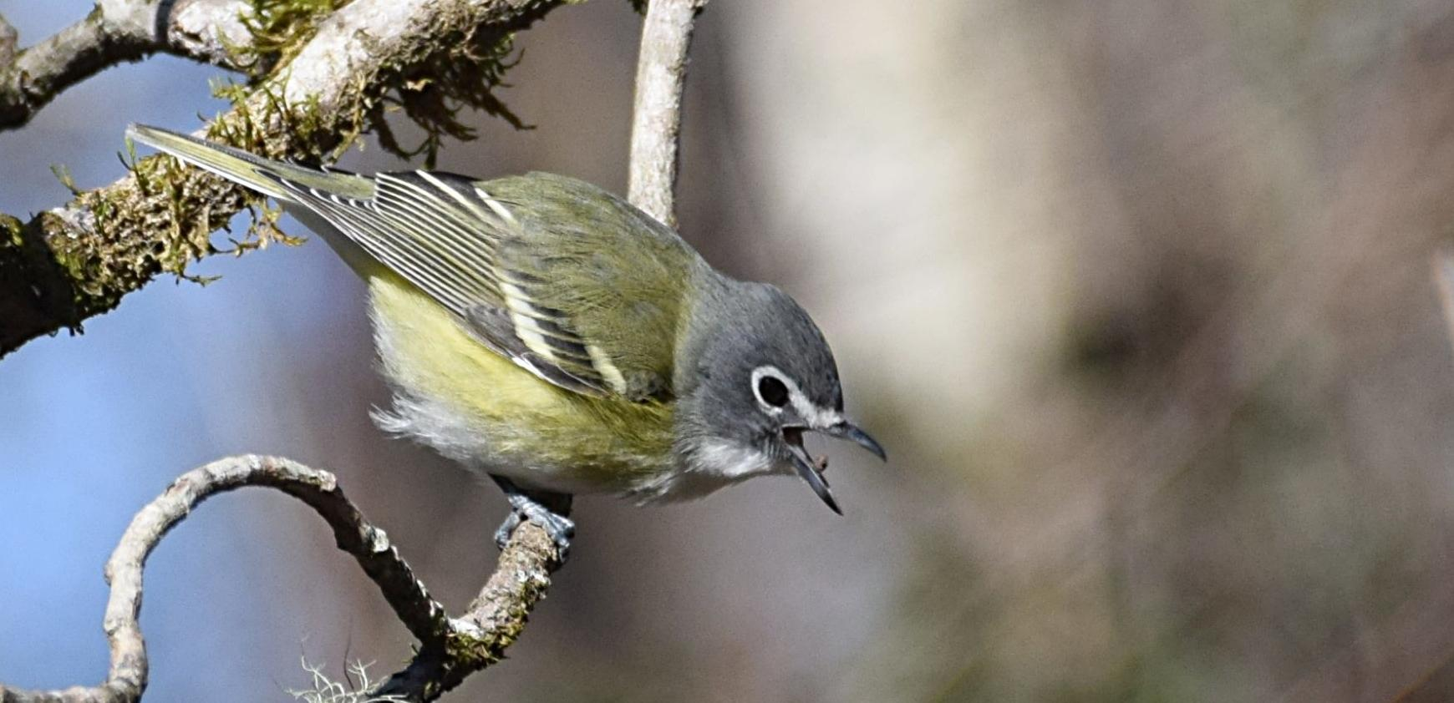
A Primer for Phylogenetic Causal Inference
Orlando Schwery (U Kentucky)
Josef Uyeda (Virginia Tech)
2026 SSB Breakout Meeting,
Baton Rouge LA
9. Jan. 2026
....but Correlation ≠
Causation!!

Slide 2

A Primer for Phylogenetic Causal Inference
Schedule
8:30 - 9:30 Lecture
9:30 - 9:45 Questions/Discussion
9:45 -10:00 Group building/introductions
10:00 - 10:30 Coffee break
10:30 - 11:00 Case Study I
11:00 - 11:30 Case Study II
11:30 - 12:00 Questions/Discussion
pollev.com/josefuyeda941

Slide 3
Why Causal Inference?
Using the term in macroevolution will probably still get you in trouble
It will not save you from “correlation ≠ causation”
We will not fully equip you to solve your own causal problems today
We are not presenting software/method
CI is a logical framework not a single tool
Our goals
Make assumptions & inference strategies explicit
Clarify how CI differs from traditional practice
Align familiar comparative methods with causal ideas
Remind that thinking causally helps generate testable predictions

Slide 4
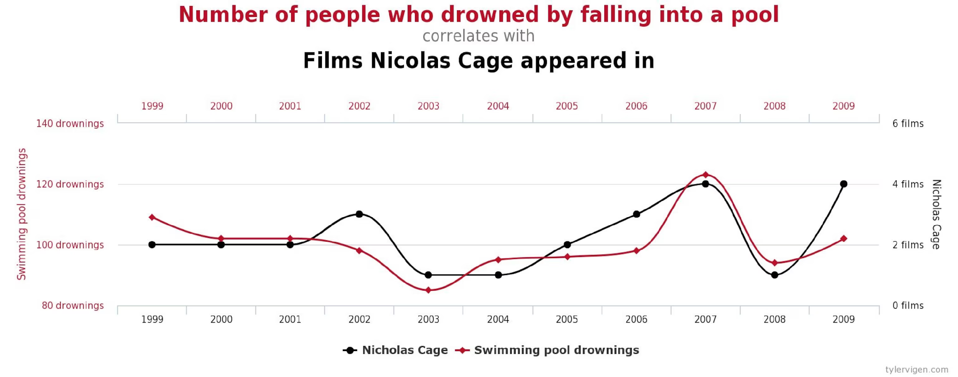
Correlation does not equal causation
pollev.com/josefuyeda941
TRUE.

Slide 5
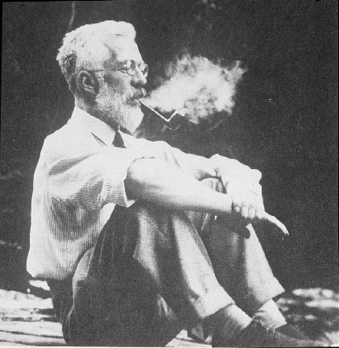
What is the “gold standard” for supporting causal claims in science?
Experiments:
Adding the “do” to science
RA Fisher
Macroevolution = (mostly) observational science

Slide 6
Do we care about/talk about causes in macroevolution?
“ecologists [macroevolutionary biologists] often qualify their results verbally to avoid making causal claims—even when their research focus is causal understanding, rather than description...This practice muddies the waters and can create confusion over whether an author is claiming an association or implying causation while allowing themselves plausible deniability.”
-Byrnes & Dee, 2024

Slide 7


Do we care about/talk about causes in macroevolution?
365 results
1,570 results
...yes, but we may hide the claims (and assumptions) behind weaker language

Slide 8
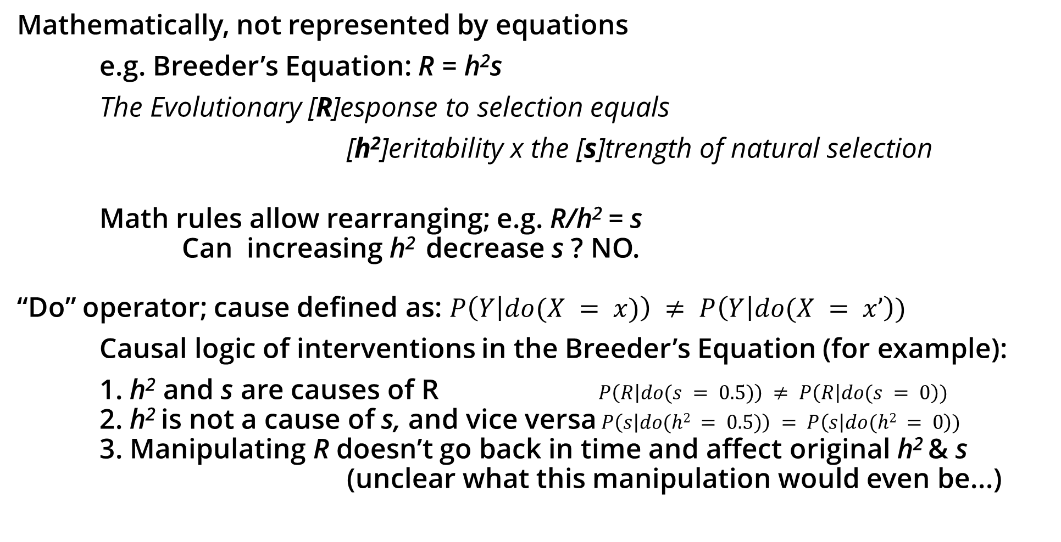
What is a cause?

Slide 9
Directed Acyclic Graph as Causal Models representing interventions “do()”
Heritability
h²
Selection differential
s
Response to selection
R

Slide 10
Confounding
Endogeneity - Explanatory variable is correlated with the error term.
Genetics
Smoking
Lung cancer

Slide 11

Deconfounding via experiments
Genetics
Random assignment to treatment group
Smoking
Lung cancer

Slide 12
Deconfounding via conditioning
Backdoor adjustment
Conditioning on G blocks backdoor path between S and L
Population stratification, Twin studies, Genotypes
etc.
e.g. regression
L ~ G + S
Genetics
Blocks non-causal backdoor between S & L
Coefficient estimates causal effect of S -> L
Requires knowing, measuring, and blocking confounding variables. Otherwise, omitted variable bias (OVB).
Smoking
Lung cancer

Slide 13
The “Elemental Confounds”
Basic ways of how three variables can be causally connected
Rules for how information flows reveal confounding dangers
Larger DAGs can be deconstructed into these!
Z
?
X
Y
Notes:
Orlando

Slide 14
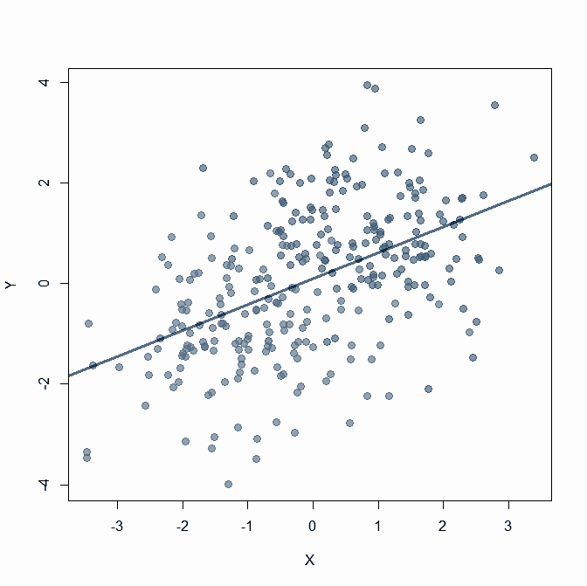
The “Elemental Confounds”
G
?
S
C
Example:
Smoking (S) is correlated with cancer (C)
We wonder whether genetics (G) could affect both
→ Should we include G in our regression?

Slide 15
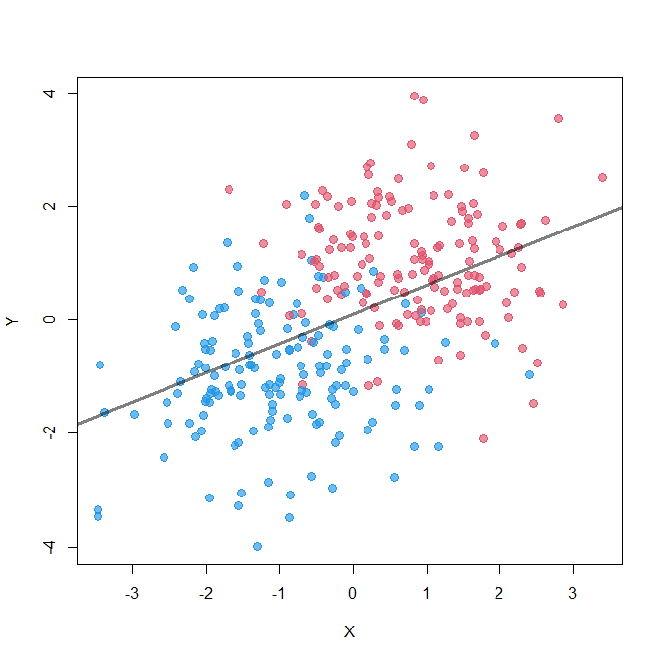
Fork: common cause as confounder
Z
X
Y
lm(formula = Y ~ X)
Estimate Std. Error t value Pr(>|t|)
(Intercept) 0.09541 0.07345 1.299 0.195
X 0.51315 0.05350 9.592 <2e-16 ***

Slide 16
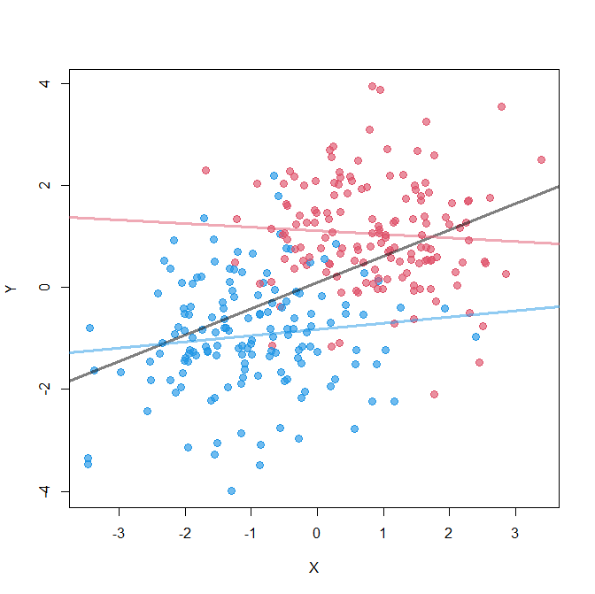
Fork: common cause as confounder
Z
X
Y
lm(formula = Y ~ X + Z)
Estimate Std. Error t value Pr(>|t|)
(Intercept) -0.91314 0.10648 -8.576 5.53e-16 ***
X 0.03208 0.06091 0.527 0.599
Z 1.93154 0.16702 11.565 < 2e-16 ***

Slide 17
Fork: common cause as confounder
Z
X
Y
Missing confounder creates spurious correlation!
lm(formula = Y ~ X + Z)
Estimate Std. Error t value Pr(>|t|)
(Intercept) -0.91314 0.10648 -8.576 5.53e-16 ***
X 0.03208 0.06091 0.527 0.599
Z 1.93154 0.16702 11.565 < 2e-16 ***

Slide 18
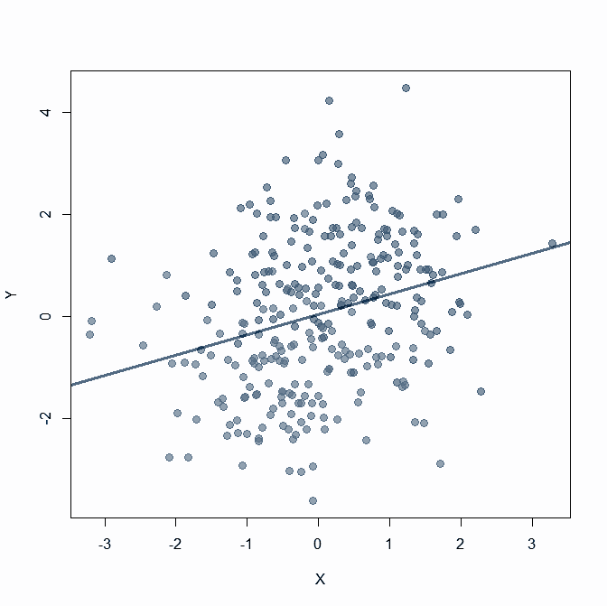
The “Elemental Confounds”
T
H
?
F
Example:
Fungus (F) affects plant height (H)
Experiment to test whether treatment (T) works
→ Should we include F in our regression?

Slide 19
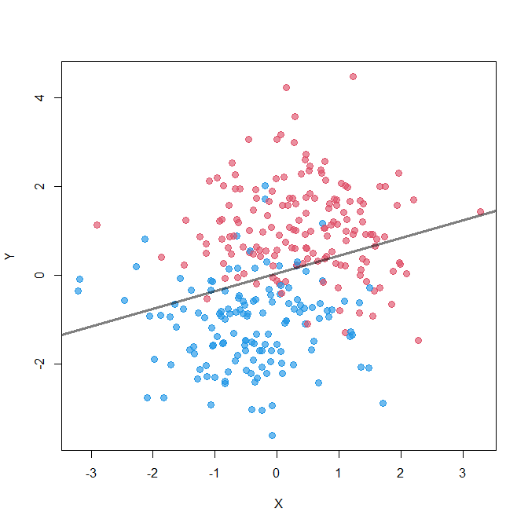
Pipe: mediator
X
Z
Y
lm(formula = Y ~ X)
Estimate Std. Error t value Pr(>|t|)
(Intercept) 0.04652 0.08174 0.569 0.57
X 0.39762 0.08046 4.942 1.29e-06 ***

Slide 20
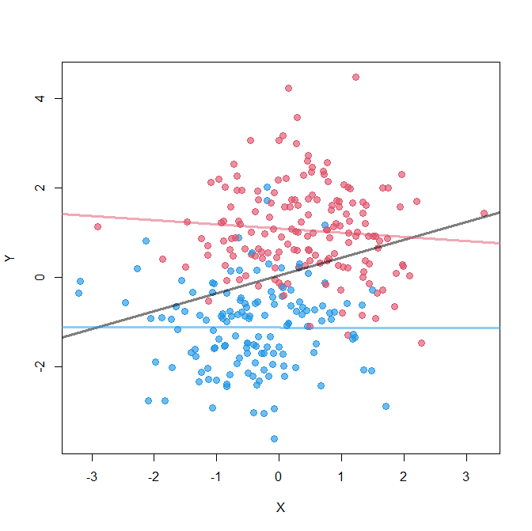
Pipe: mediator
X
Z
Y
lm(formula = Y ~ X + Z)
Estimate Std. Error t value Pr(>|t|)
(Intercept) -1.13684 0.08815 -12.897 <2e-16 ***
X -0.05336 0.06185 -0.863 0.389
Z 2.22261 0.12596 17.645 <2e-16 ***

Slide 21
Pipe: mediator
X
Z
Y
Blocking effects
(Post-treatment bias)
lm(formula = Y ~ X + Z)
Estimate Std. Error t value Pr(>|t|)
(Intercept) -1.13684 0.08815 -12.897 <2e-16 ***
X -0.05336 0.06185 -0.863 0.389
Z 2.22261 0.12596 17.645 <2e-16 ***

Slide 22
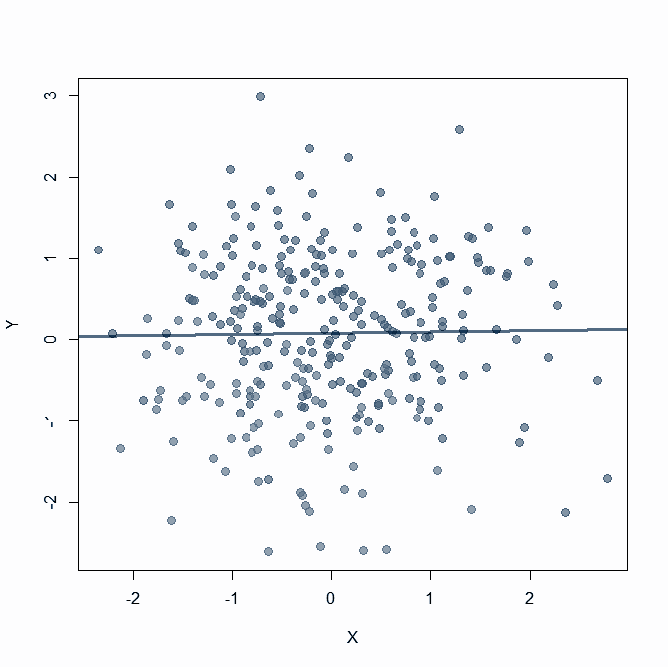
The “Elemental Confounds”
H
?
E
D
Example:
Studying health effects of exercise (E) on diet (D)
Hospitalisation (H) as related proxy for health
→ Should we include H in our regression?

Slide 23
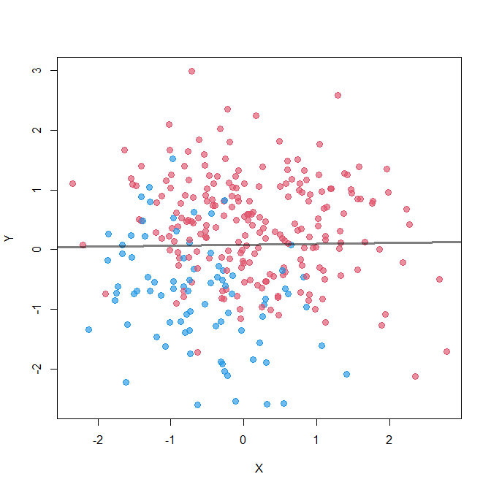
Collider: common effect
Z
X
Y
lm(formula = Y ~ X)
Estimate Std. Error t value Pr(>|t|)
(Intercept) 0.08051 0.05753 1.399 0.163
X 0.01505 0.05947 0.253 0.800

Slide 24
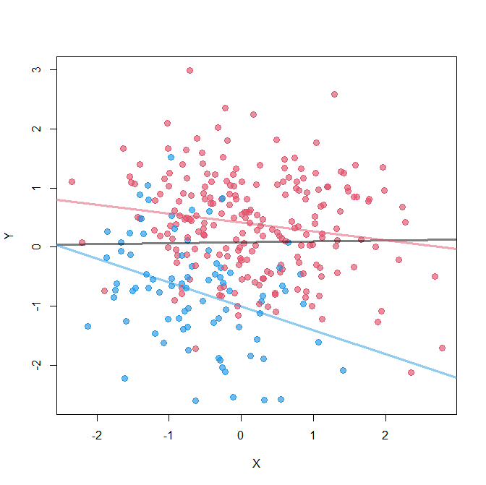
Collider: common effect
Z
X
Y
lm(formula = Y ~ X + Z)
Estimate Std. Error t value Pr(>|t|)
(Intercept) -0.87400 0.09826 -8.894 < 2e-16 ***
X -0.20154 0.05363 -3.758 0.000206 ***
Z 1.29728 0.11625 11.160 < 2e-16 ***

Slide 25
Collider: common effect
Z
X
Y
Sampling bias /
Bad (endogenous) controls
lm(formula = Y ~ X + Z)
Estimate Std. Error t value Pr(>|t|)
(Intercept) -0.87400 0.09826 -8.894 < 2e-16 ***
X -0.20154 0.05363 -3.758 0.000206 ***
Z 1.29728 0.11625 11.160 < 2e-16 ***

Slide 26
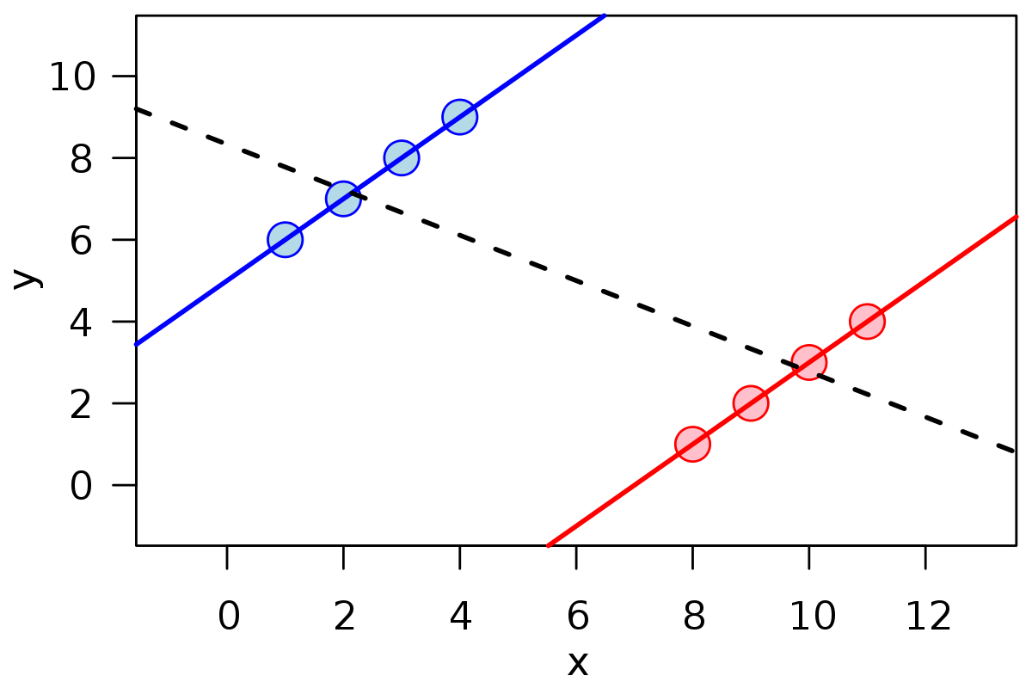
Simpson's paradox
Notes:
Josef

Slide 27
Simpson's paradox
Male recovery rate
Drug: 60% (18/30)
No drug: 70% (7/10)
Female recovery rate
Drug: 20% (2/10)
No Drug: 30% (9/30)
Combined
recovery rate:
Drug: 50% (20/40)
No drug: 40% (16/40)

Slide 28
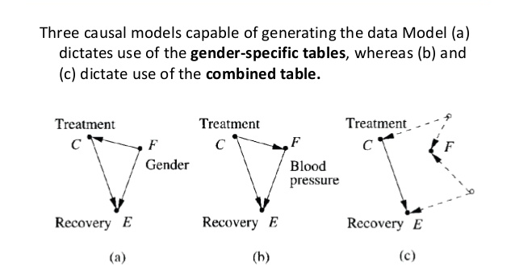
Causal interpretations

Slide 29
Major takeaways of Causal Inference
Prediction vs. Causal Inference
Including all covariates that improve prediction (e.g. AIC model selection) Including covariates justified by the causal hypothesis
What we can do:
DAGs are hypotheses of generating processes
Makes causal assumptions explicit & justifies estimation/identification strategy if the DAG were correct (e.g. Backdoor adjustment)
Doesn’t solve “cor ≠ cause”, but CAN REJECT implausible causal hypotheses
Leaves plausible causal hypotheses & how they could be distinguished
More identification strategies available than just Backdoor adjustment (e.g. frontdoor adjustment, instrumental variables)

Slide 30
Other options besides backdoor adjustments in Causal inference
Instrumental variables
Front door adjustment
Z
Z
I
X
Y
X
M
Y
IV: A 3rd variable (I) that only affects Y through its effect on X. (e.g. Tax rate on smoking products)
FDA: A 3rd variable (M) that mediates the effect of X on Y. (e.g. Tar levels in lungs mediating the effect of smoking on lung cancer)

Slide 31
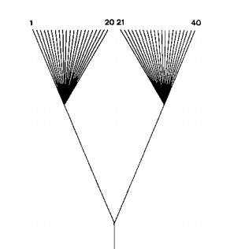
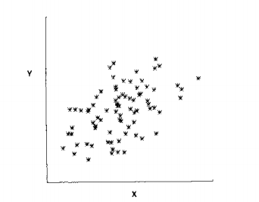
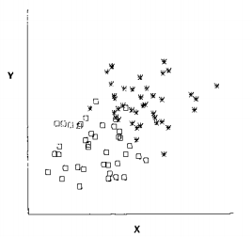
Application to phylogenetic comparative methods

Slide 32
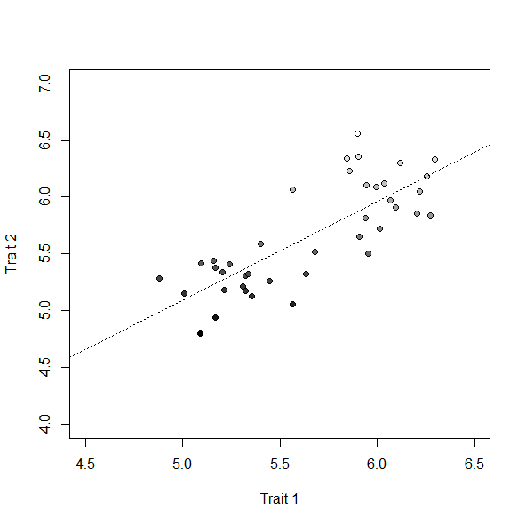
The Felsenstein Scenario
T₁
T₂
Notes:
‹#›

Slide 33
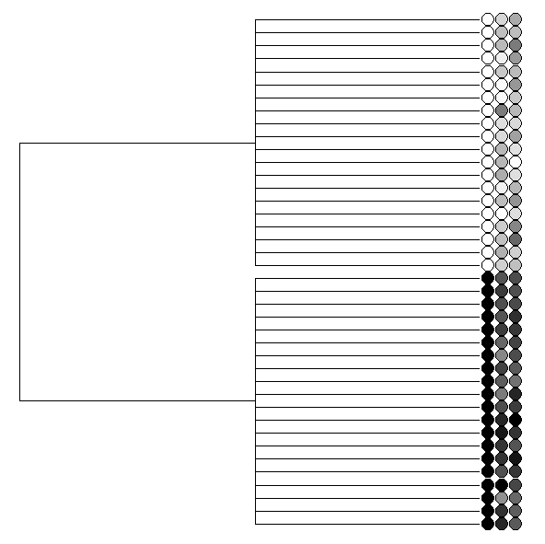
The Felsenstein Scenario
T₁
T₂
Notes:
‹#›

Slide 34
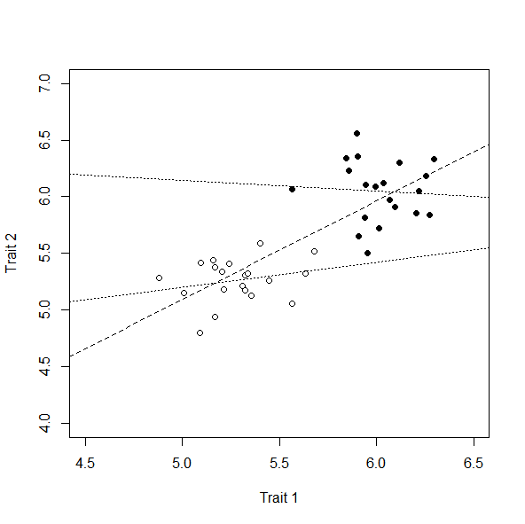
The Felsenstein Scenario
T₁
T₂
Notes:
‹#›

Slide 35
The Felsenstein Scenario
Spurious correlation due to confounding effect of phylogeny
(endogenous causal variable)
Ψ
T₁
T₂
T₁
T₂
Notes:
‹#›

Slide 36
Simpson's paradox
Notes:
Josef

Slide 37

ψ
Body Size
Mig.
Pop. N

Slide 38
Body Size
Mig.
ψ
Pop. N

Slide 39
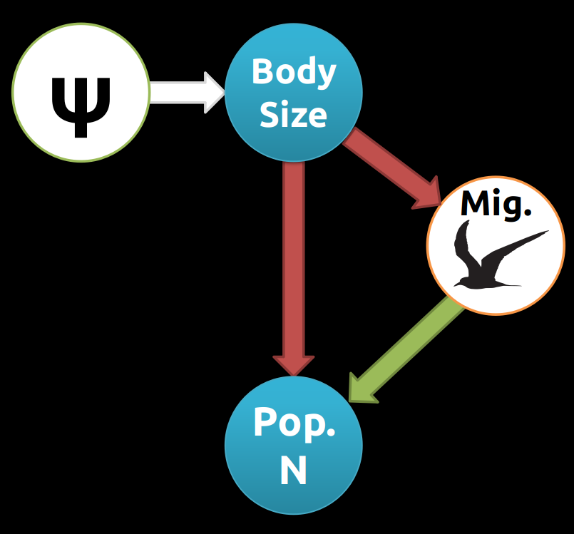
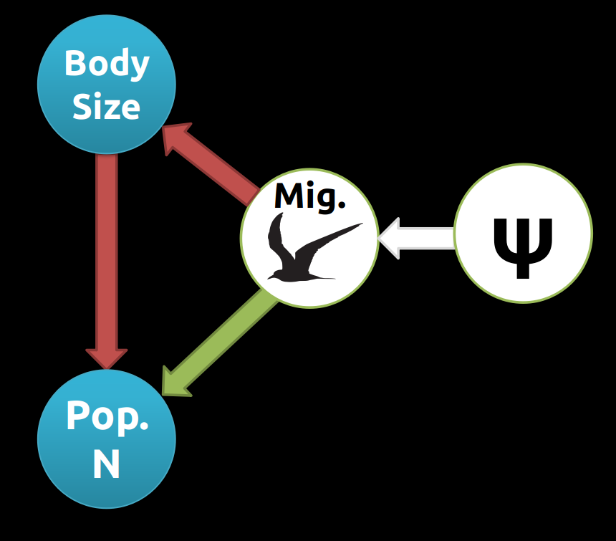
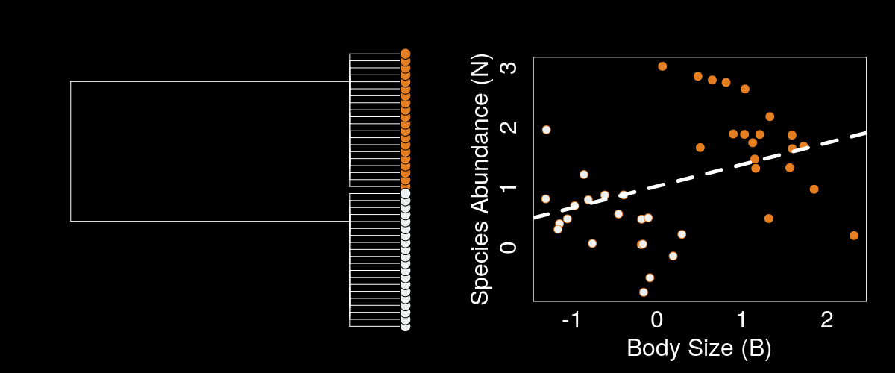
Phylogeny blocked

Slide 40
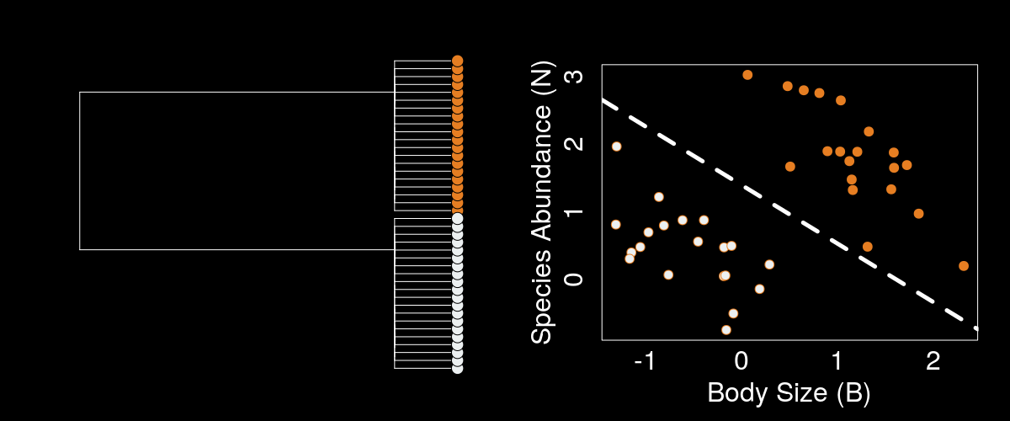
Phylogenetic confounding

Slide 41
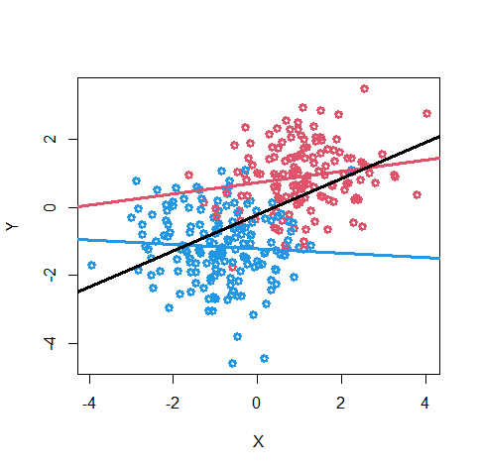
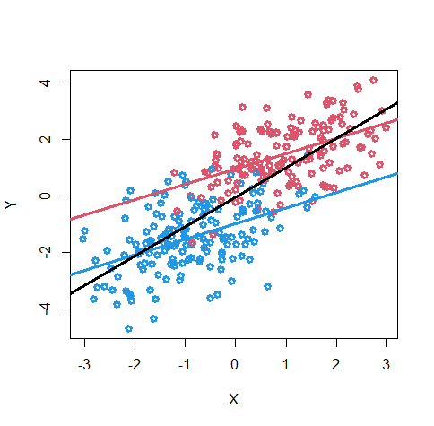
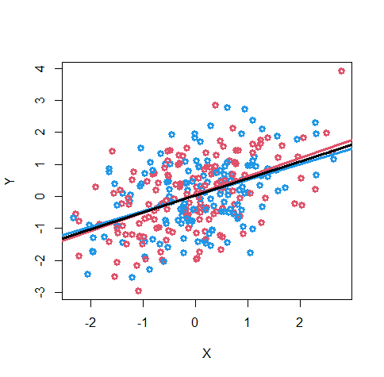
d-separation: testing the DAG
Z
DAG implies X ⊥ Y
fit: Y ~ X + Z
X
Y
Z
Testing models by a D-sep test.
Which model best predicts conditional independencies in the data?
X
Y
X
Y

Slide 42
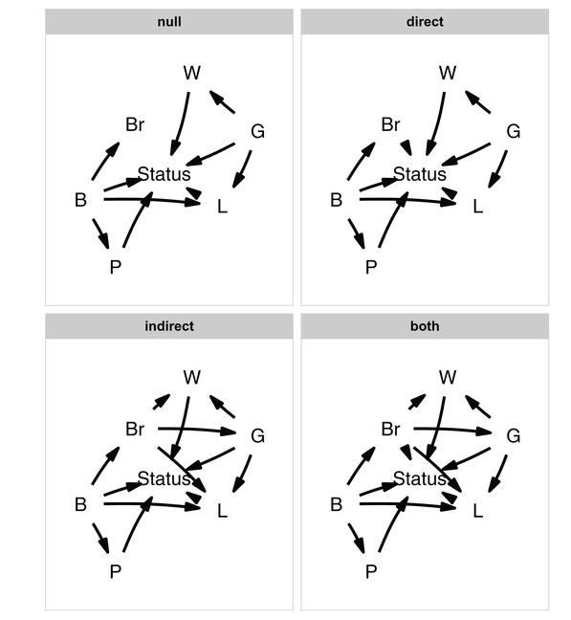
Phylopath
(Hardenberg & Gonzalez-Voyer 2013;Gonzalez-Voyer & Hardenberg 2014; van der Bijl 2018)
D-sep
Test for Conditional independence of:
Y|X ⊥ Z
Y|X ~ Z using PGLS (e.g. BM, BM + λ, OU)
Z
X
Y
If DAG is plausible, coefficient not significant
What is this doing?
Accounts for expected phylogenetic covariance of residuals under model
Because PGLS, all historical effects mediated through present-day trait values. Ancestral confounders unrelated to Z affecting Y|X.
Large events/shifts likely to induce significance due to BM model violations (could use robust regression etc, but assumes specific causes of outliers=>i.e. replaces one causal assumption with another)
Bottom line:
Phylopath allows evaluation of d-separation among a specific set of causal models, but has strong assumptions about model and causes of phylogenetic residual covariance. Assumes residual covariance is only noise, not causal signal Assumes only present-day values matter for causation (causal lags don’t exist) Works only if both the DAG and residual model are correct (e.g. Large shifts will violate BM, but may not indicate the DAG itself is wrong, but lead to rejection of the DAG)

Slide 43
Can we use causal “do” logic across a broader set of causal scenarios?

Slide 44
Omitted Variable Bias
So far, we’ve considered if confounder is measured. What if it is not known and/or measured?
Modeling correlation in error structure based on phylogeny = phylogenetic random effects
Random effects assumption: Random effects must not be correlated with any covariates in the regression; or else estimates are biased.

Slide 45
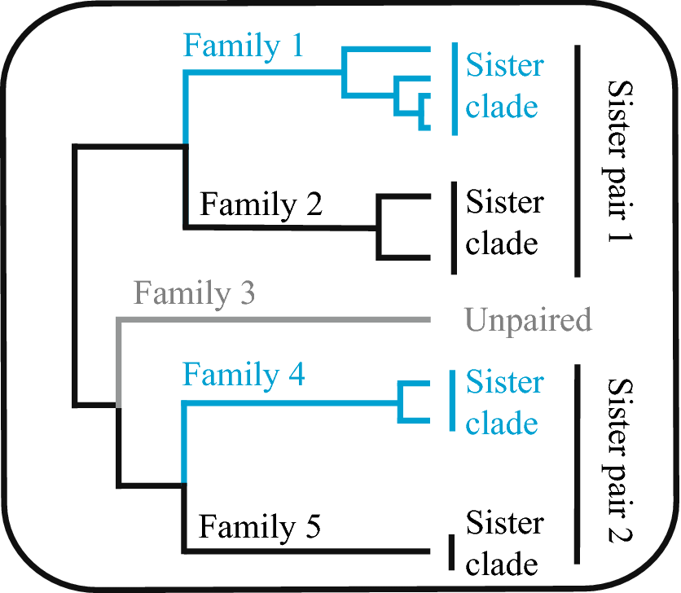
Sister pair analyses
Identify independent sister clades that differ in X Test for a difference in Y Sample N = Number of pairs Benefits from a CI perspective:
Conditions on shared due to confounders due to common ancestry (see “econometric fixed effects design” of Byrnes & Dee 2024)
Downside:
Doesn’t use all the information in the phylogeny, smaller sample size and fewer degrees of freedom
Assumes confounders are constant within sister comparisons
Figure from: Ritchie, A. M., Hua, X., & Bromham, L. (2022). Diversification rate is associated with rate of molecular evolution in ray-finned fish (actinopterygii). Journal of Molecular Evolution, 90(2), 200-214.

Slide 46
Observed
Omitted
Z
Z
Z
X
Y
X
Y
X
Y
mvBM
(generating process that inspired PICs. Covariance estimator)
PGLS
(Assumption of a PGLS that would identify causal effect of X on Y)
PGLS w/endogeneity
(Estimate of causal effect of X on Y biased! Covariance estimator)

Slide 47
Ѱ
X ⊥ Ѱ
λ_{X} = 0, means that X is consistent with ancestry independence
Z
Y|X ⊥ Ѱ
λ_{Y|X} > 0, means that the residual variation IS correlated with ancestry
X
Y
λ_{Y|X} > 0
λ_{X} = 0
λ_{Y} > 0
Subject to statistical estimation caveats, suggests that the backdoor path between Z -> X may not be open!
X-> Y being a causal effect is plausible.

Slide 48
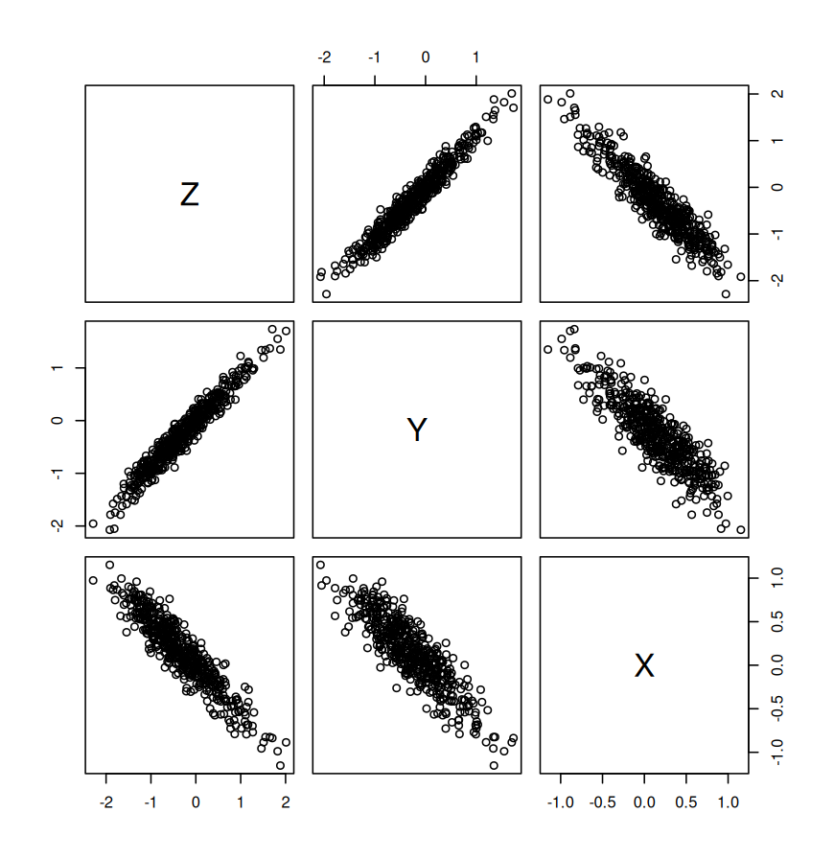
Observed
Omitted
Z
Y = 0.3*X
+ 1*Z
Ѱ
Z
X = -0.5*Z
X
Y

Slide 49
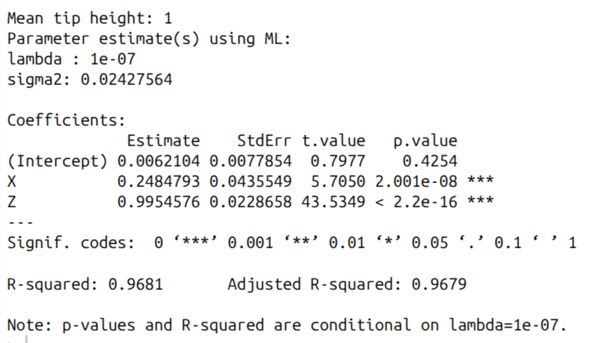

Slide 50
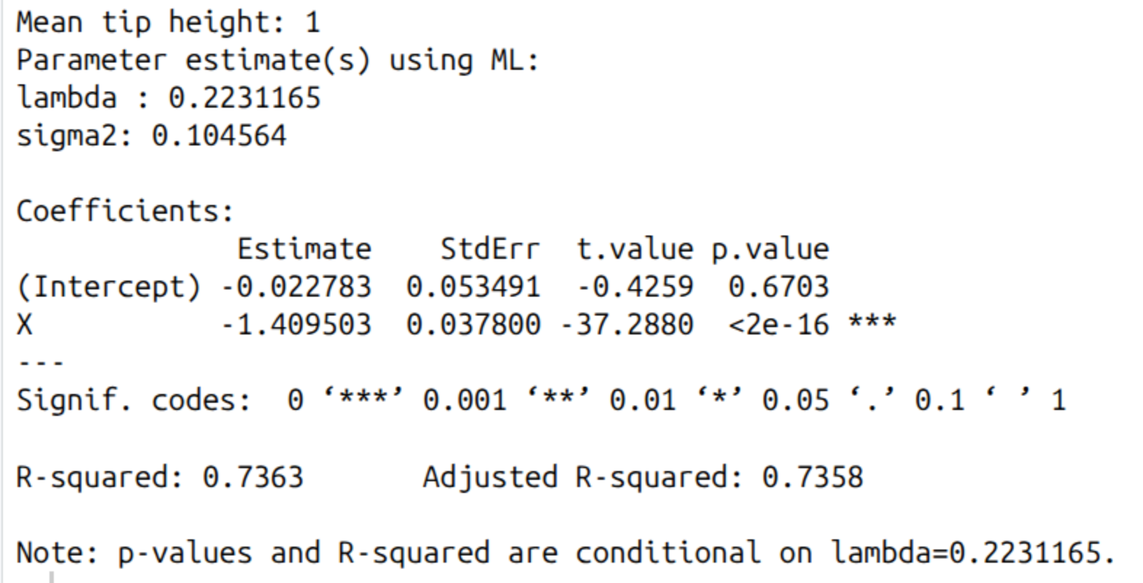

Slide 51
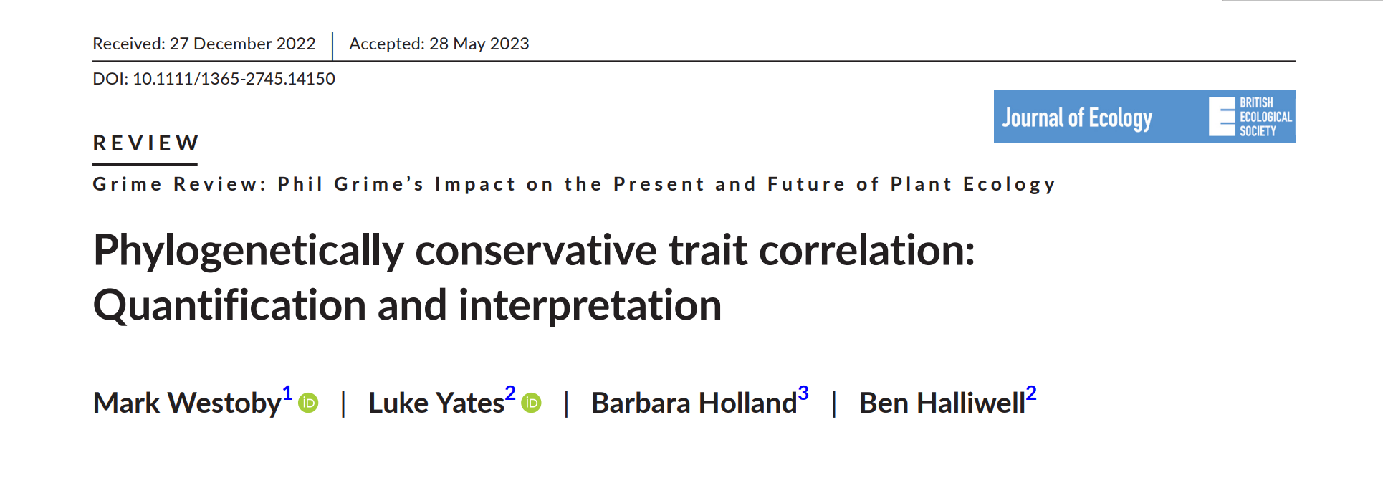
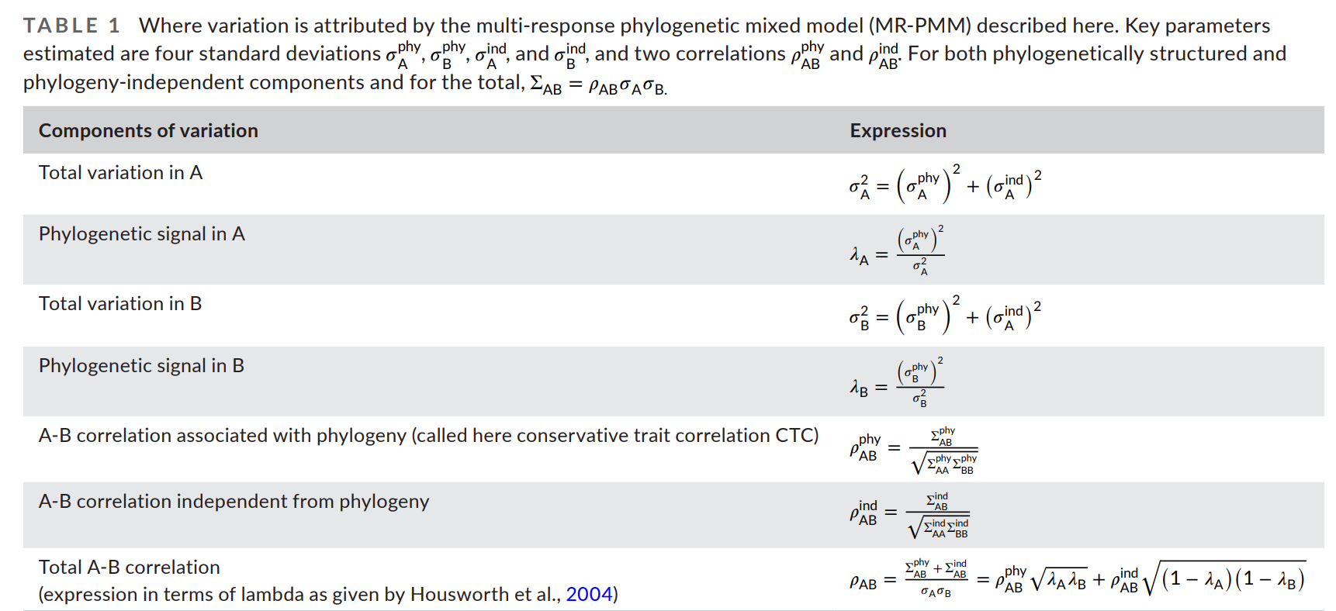
Ѱ
Z
X
Y

Slide 52
How often do you have a change in X and what’s the timescale of causation?
A singular event
A few events
A bunch of events
Continuous feedback

Slide 53
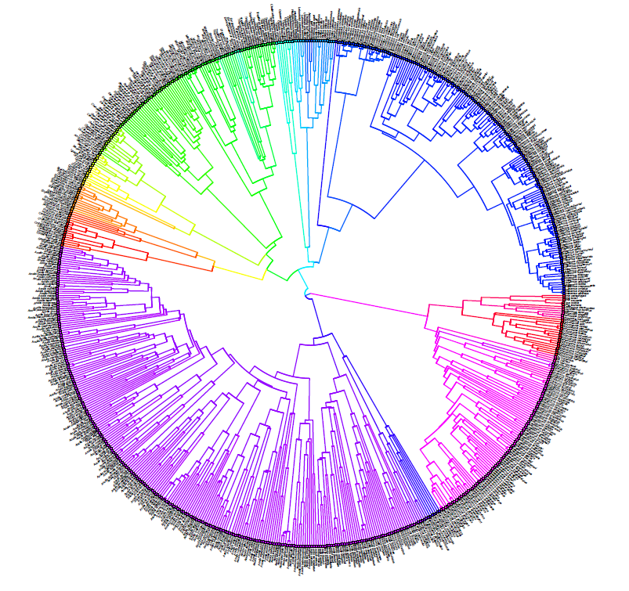
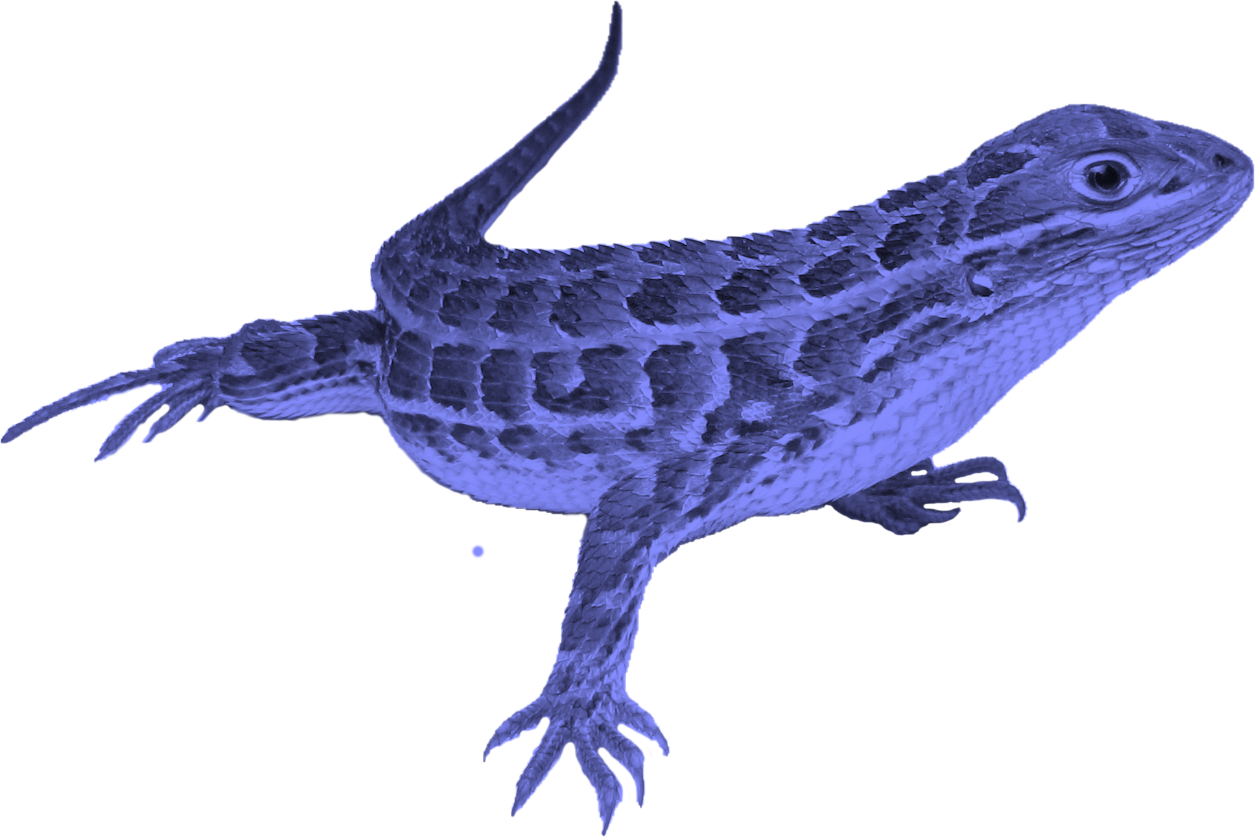
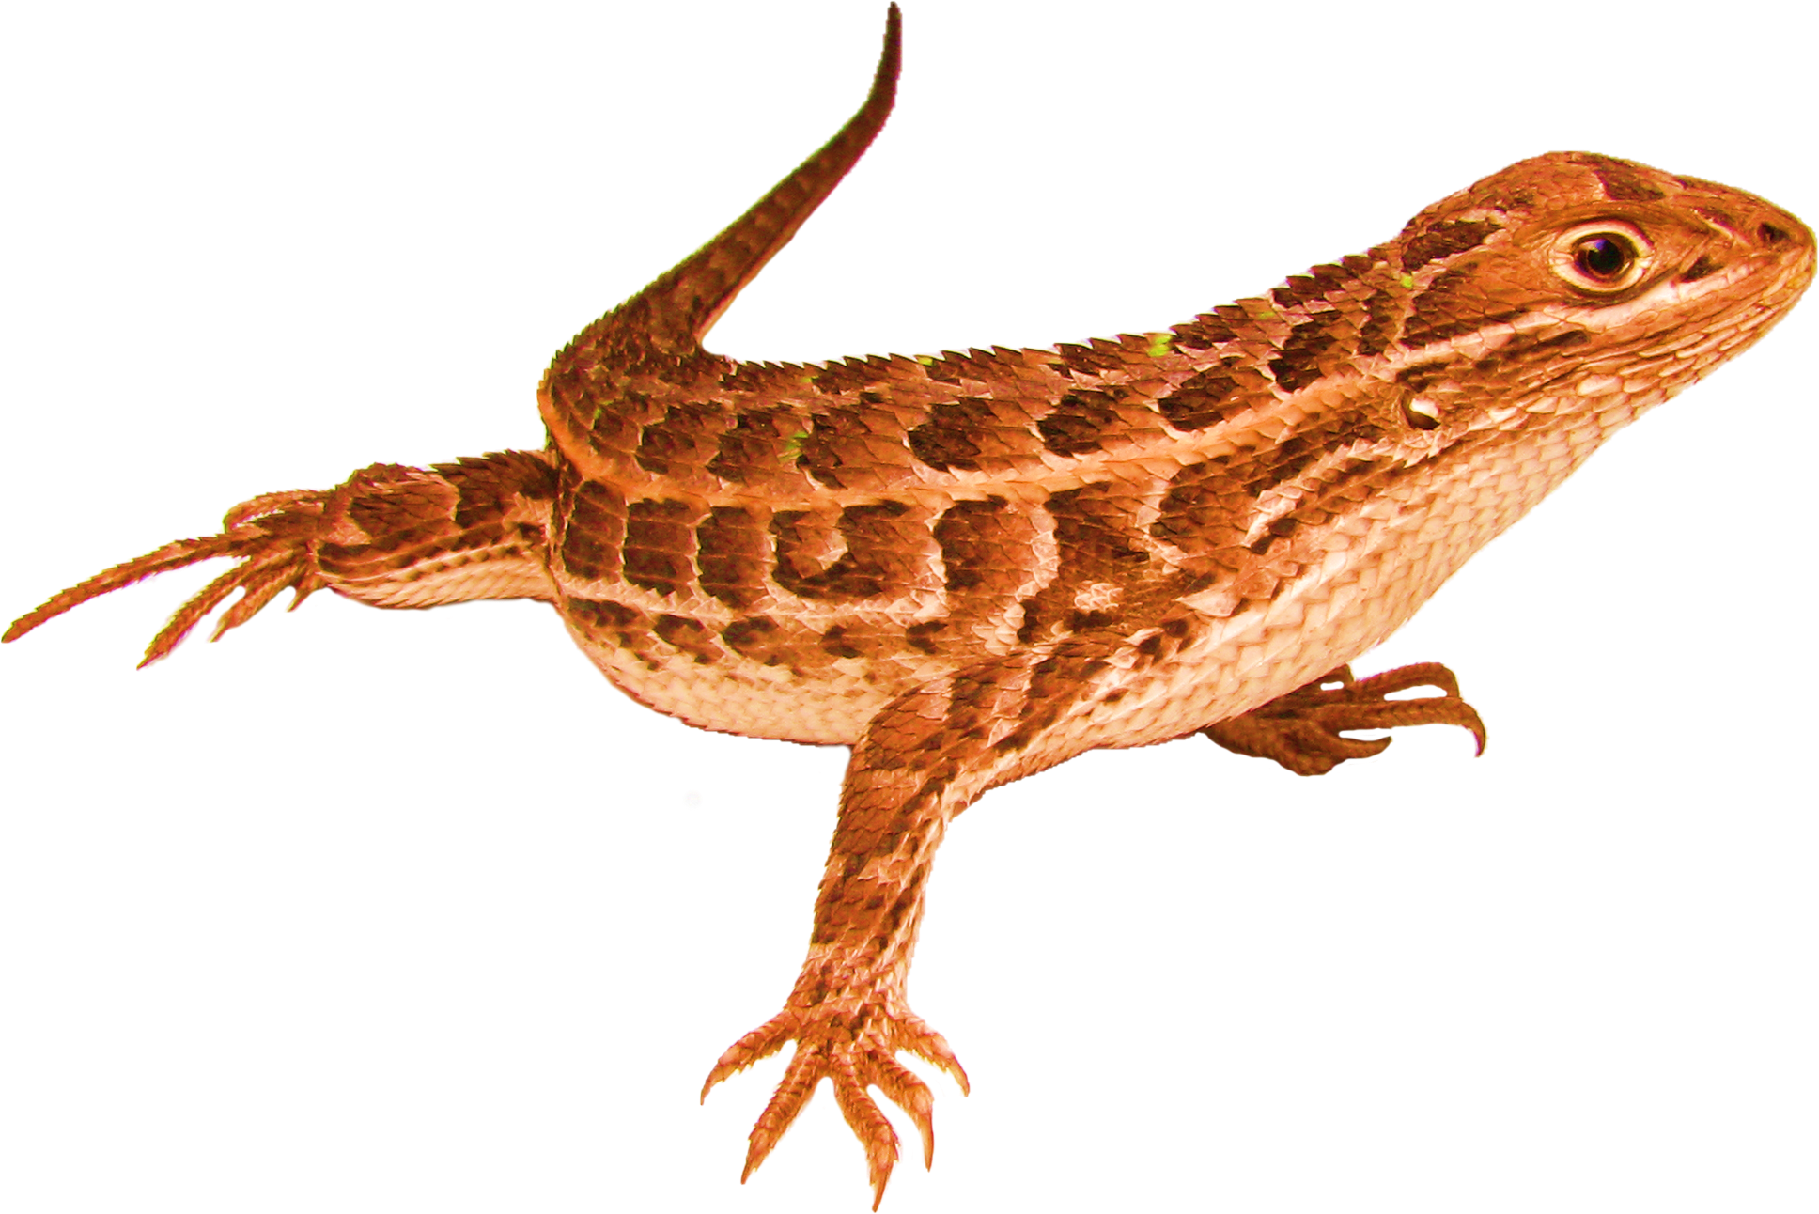
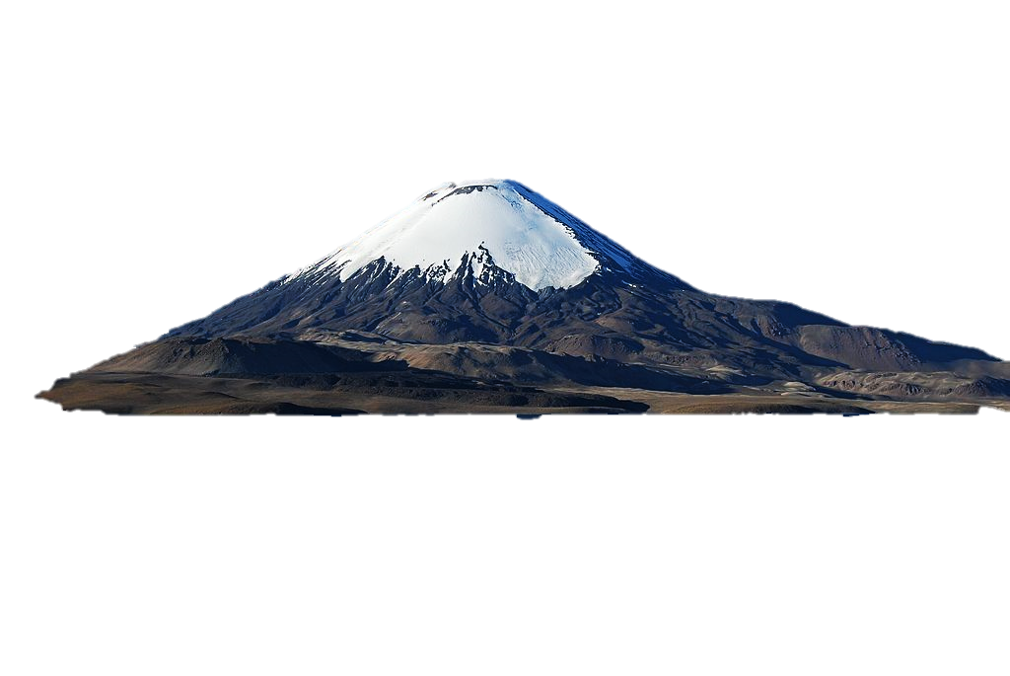
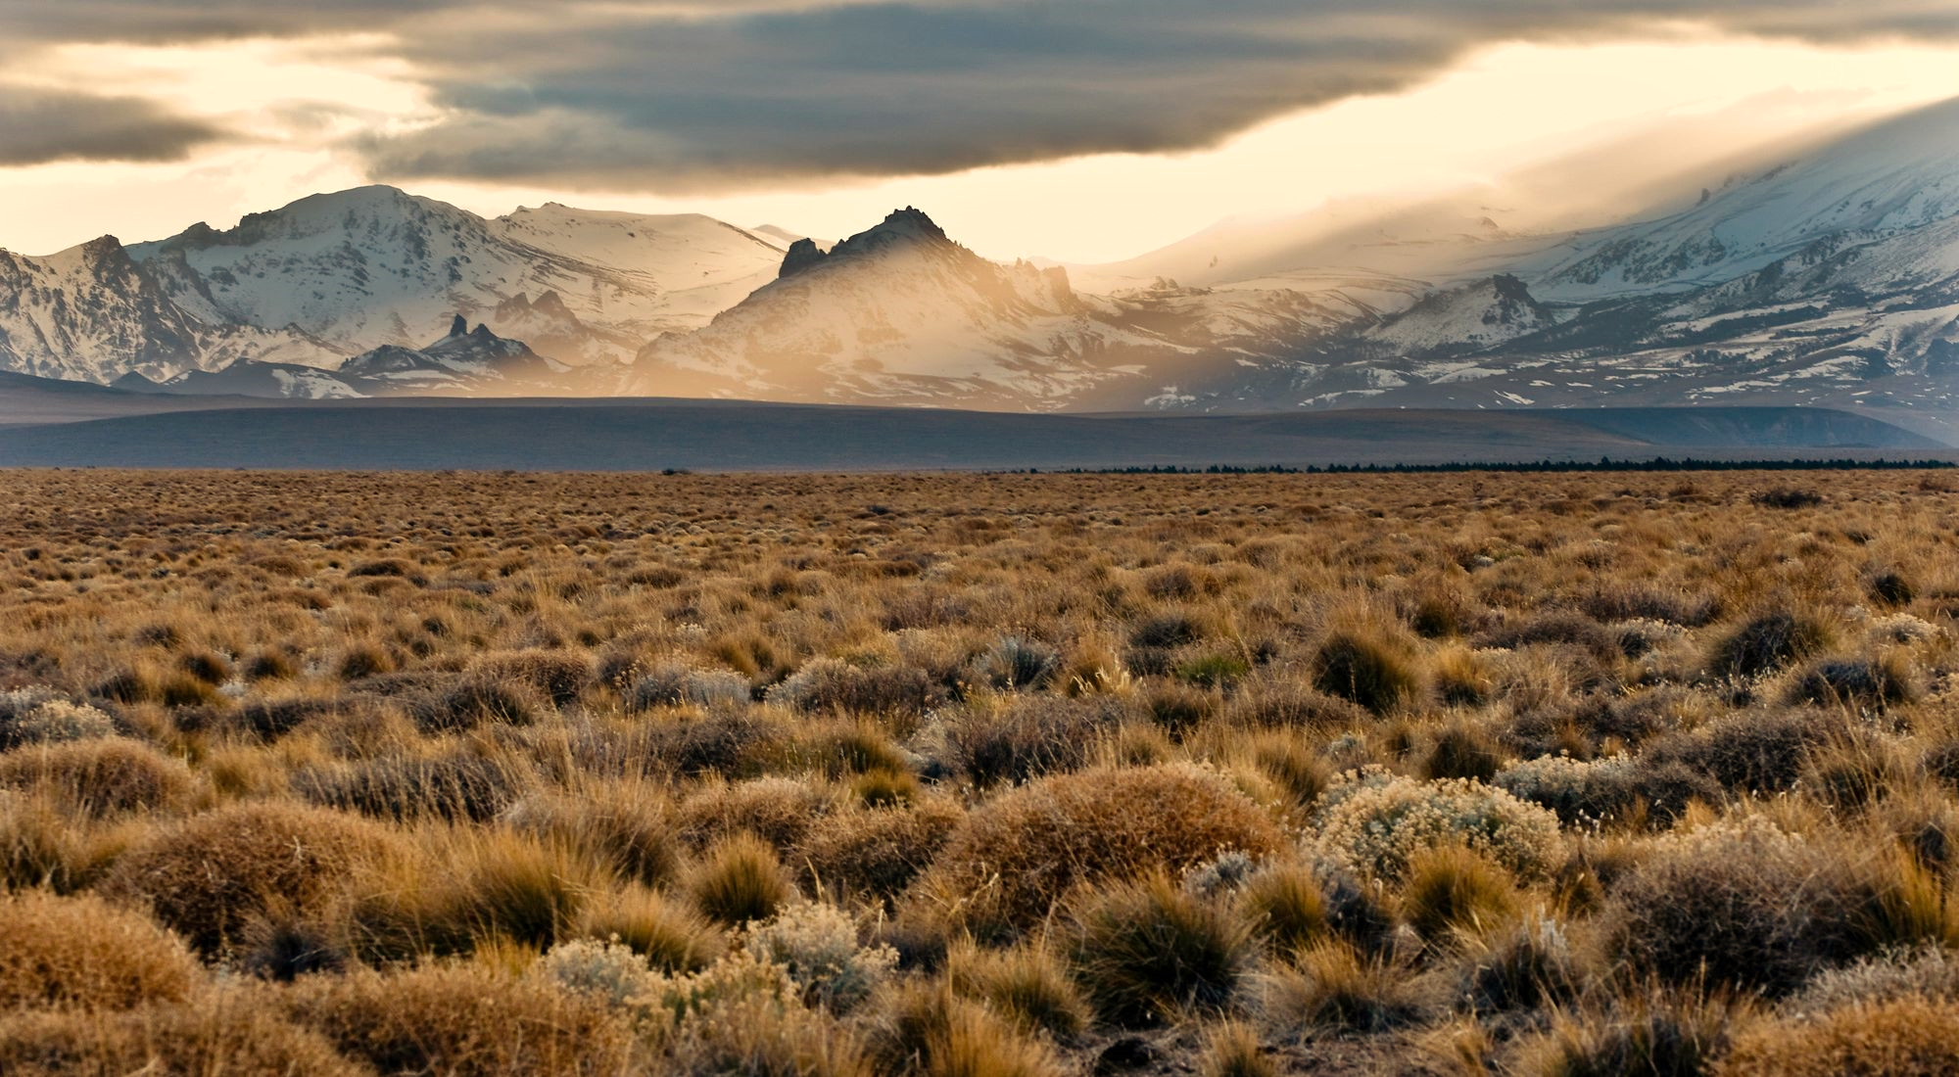
Alencar et al.: Diversification of Pleurodonta
Diverse group of lizards in the Americas
Incl. anoles, iguanas, spiny and horned lizards
Dated phylogeny:
733/1111 species, based on Tonini et al. (2016)
Focal traits:
Reproductive mode (oviparous/viviparous)
Occurrence in Andean mountains (or not)

Slide 54
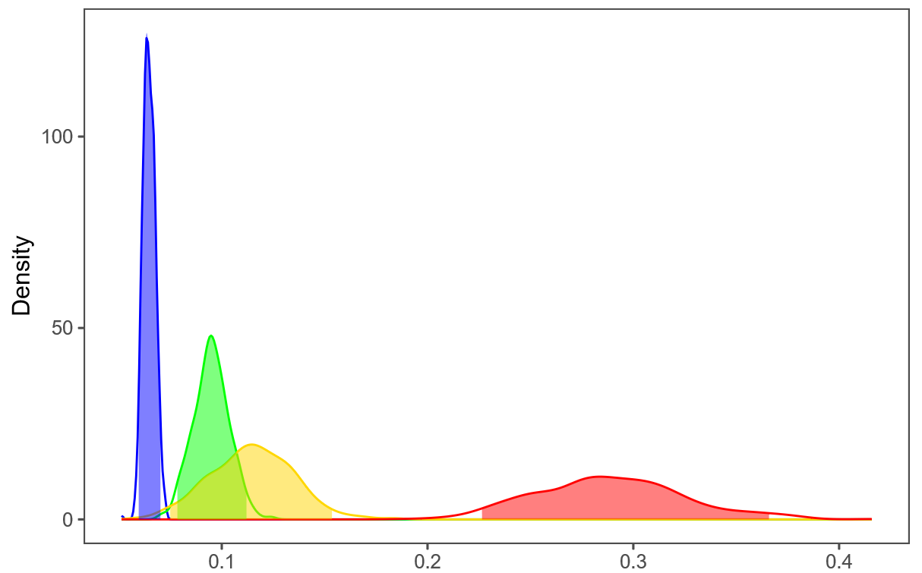
Combination of Viviparity & Andes drives Radiation?
AM
V
E.g.: 4-state MuSSE result
λ
λ₀
λ₀
Density
µ₀
µ₀
00
01
10
11
Net Diversification
µ₁
µ₁
λ₁
λ₁

Slide 55
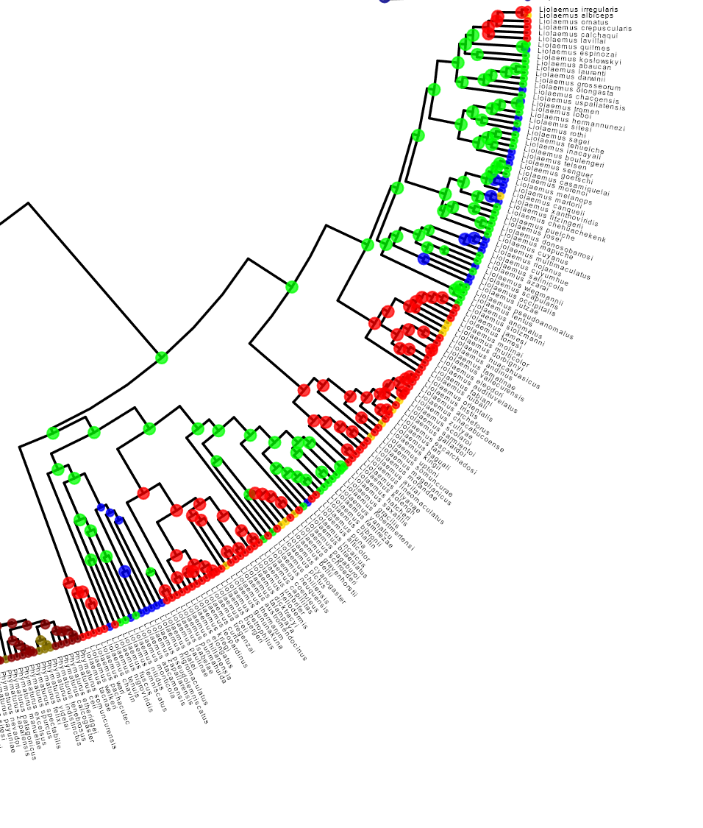
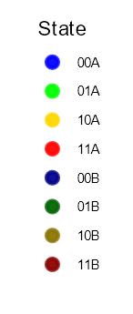
Data-Disbelief
Is it plausible that the predominantly Andean viviparous clades diversify fastest?
How do they compare to their Andean oviparous (and other) sister clades?
AM
?
V
λ
Notes:
Based on our results, the viviparous Andean lineages in red, should diversify fasterst.
Are they faster than their Andean oviparous sister clades then?

Slide 56
Data-Disbelief
Is it plausible that the predominantly Andean viviparous clades diversify fastest?
How do they compare to their Andean oviparous (and other) sister clades?
AM
?
V
λ
Notes:
It doesn’t really look like it though! This should make us suspicious…

Slide 57
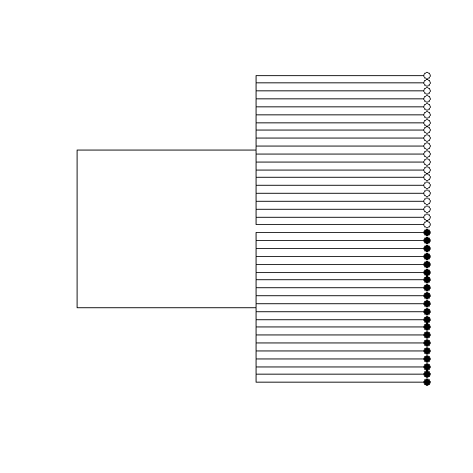
Causal Diversification: Conditioning on ‘known’ rate shifts
Diversification of Pleurodonta:
What are actual effects of viviparity and Andean mountains?
Re: Felsenstein:
What are the 'latent' clades we need to condition on?
?
Notes:
So what does that mean for Pleurodonta? Can we get the actual effects of viviparity and the Andes, unconfounded by hidden states? What are the ‘latent’ clades in the Felsenstein scenario that we need to condition on?

Slide 58
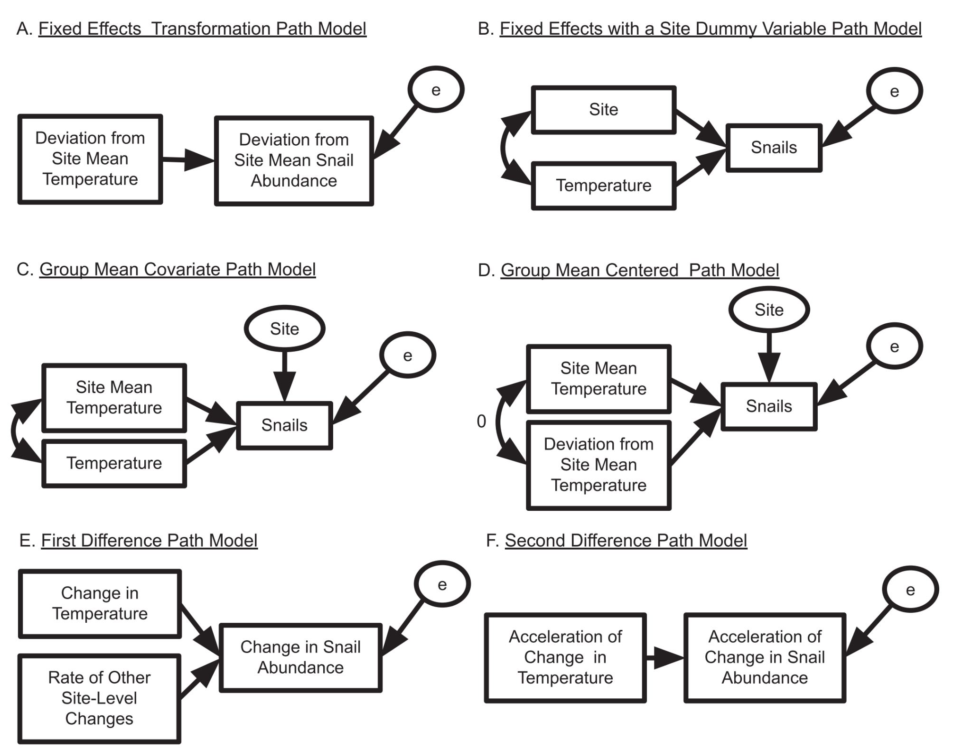
Causal Diversification: Conditioning on ‘known’ rate shifts
Diversification of Pleurodonta:
What are actual effects of viviparity and Andean mountains?
Re: Felsenstein:
What are the 'latent' clades we need to condition on?
?
Fixed effects with a regime dummy variable path model
Clade/regime
λ
X
Notes:
So what does that mean for Pleurodonta? Can we get the actual effects of viviparity and the Andes, unconfounded by hidden states? What are the ‘latent’ clades in the Felsenstein scenario that we need to condition on?

Slide 59
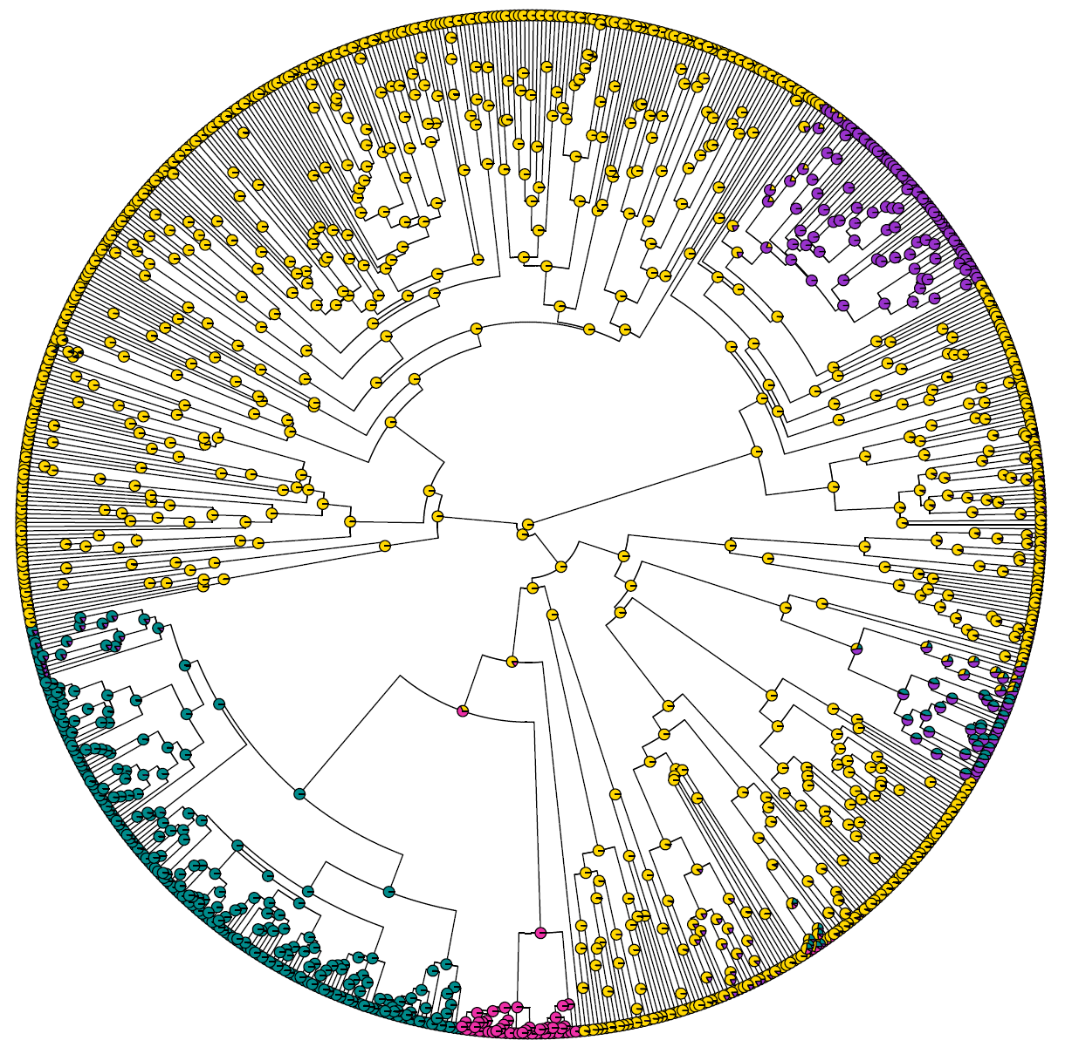
Causal Diversification: Conditioning on ‘known’ rate shifts
Diversification of Pleurodonta:
What are actual effects of viviparity and Andean mountains?
Re: Felsenstein:
What are the 'latent' clades we need to condition on?
Infer overall rate heterogeneity/shifts, e.g.:
Shifts between rate categories
MiSSE model (SSE w/o traits)
Notes:
Our solution is to first quantify the overall rate heterogeneity, i.e. clades with different diversification rates or shifts in those rates. We use MiSE here, which you can think of as the SSE version of BAMM.
We find that there’s four different rate categories in Pleurodonta.

Slide 60
Causal Diversification: Conditioning on Shift Regimes
How to test traits while conditioning on the observed rate shifts?
🡪 Create Pseudo-trait:
Merge MiSSE-states with traits
Analyse as 8-state MuSSE
0
A
B
1
C
D
Notes:
… giving us 8 states in this ‘pseudo-trait’, which we can then analyse with a simple 8-state MuSSE.
(while the model looks intimidating, it’s not that bad, because all those states are ‘observed’ now)

Slide 61
Causal Diversification: Conditioning on Shift Regimes
How to test traits while conditioning on the observed rate shifts?
🡪 Create Pseudo-trait:
Merge MiSSE-states with traits
Analyse as 8-state MuSSE
λ_{00A}
λ_{01A}
µ_{00A}
µ_{01A}
0A
q₀₁
0B
q_{AB}
q₁₀
q_{BA}
q₀₁
q₁₀
q₀₁
q₁₀
λ_{00A}
λ_{01A}
µ_{00A}
µ_{01A}
0C
q₀₁
0D
q₀₁
1A
1B
q₁₀
q₁₀
µ_{10A}
µ_{11A}
0
A
B
λ_{10A}
λ_{11A}
q₀₁
q₁₀
q₀₁
q₁₀
q_{AB}
q₀₁
1C
1D
1
C
D
q_{BA}
q₁₀
µ_{10A}
µ_{11A}
λ_{10A}
λ_{11A}
Notes:
… giving us 8 states in this ‘pseudo-trait’, which we can then analyse with a simple 8-state MuSSE.
(while the model looks intimidating, it’s not that bad, because all those states are ‘observed’ now)

Slide 62
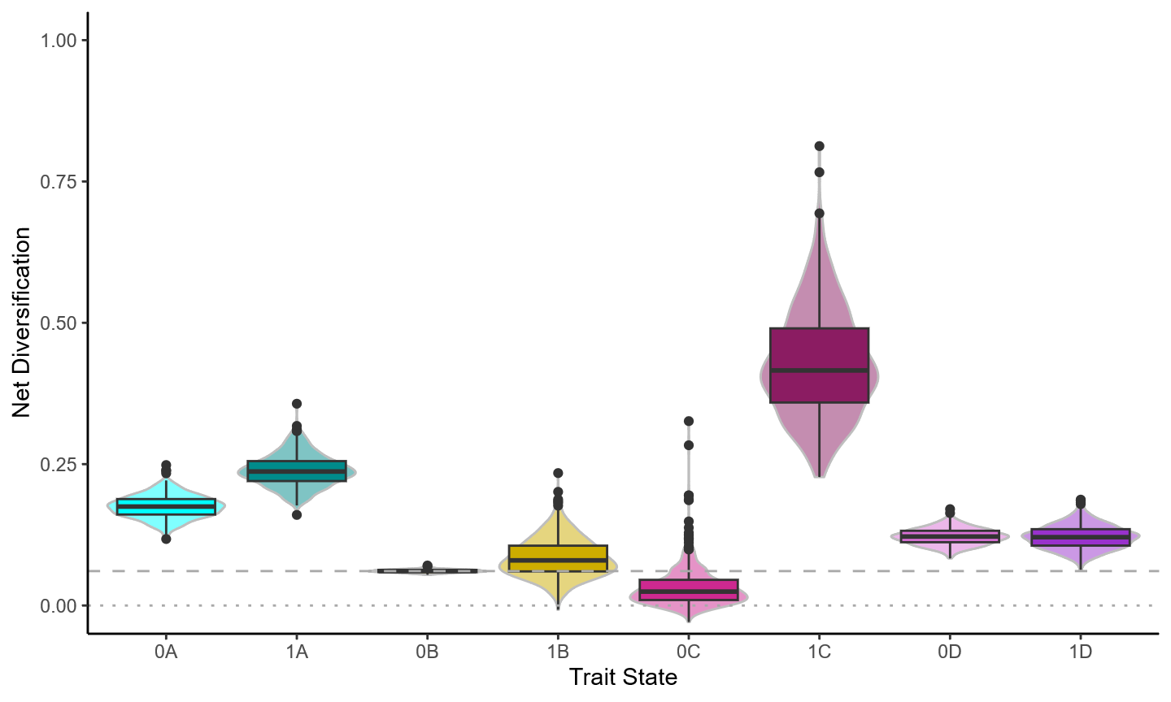
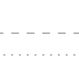
Causal Diversification: Overall Result
Net Diversification rates for combinations of rate shift clades & trait states
Viviparity
Phymaturus
Liolaemus
'Background'
Iguanas & Sceloporus
Notes:
… and two clades comprising Iguanas and part of the genus Sceloporus.
For each of these clades, we have a rate estimate for the absence and presence of the focal trait (i.e. for oviparous and viviparous lineages)

Slide 63
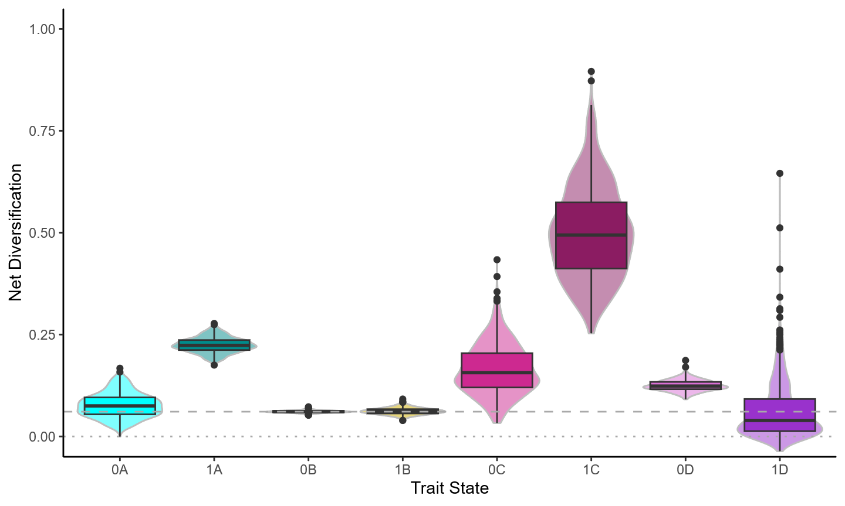
Causal Diversification: Insights to be gained
In some clades, traits have no effect
In Liolaemus
Andes could explain the whole shift
Viviparity explains little at best
In some rate shifts, the traits explain…
… only part of the shift
… none of the shift
Viviparity
Andean Mountains

Slide 64
Causal Diversification: Insights to be gained
We learn about our rate shifts:
Mountains explain some
Viviparity barely any
Some remain unexplained
In some clades, traits have no effect
In Liolaemus
Andes could explain the whole shift
Viviparity explains little at best
In some rate shifts, the traits explain…
… only part of the shift
… none of the shift
Viviparity
Andean Mountains

Slide 65
Causal Diversification: Conditional Effect Sizes
🡪 Focus on Liolaemus:
Viviparity
Andean Mountains
Liolaemus
Liolaemus
Notes:
Now let’s focus on the Liolaemus clade to look at what the d-sep test can tell us:

Slide 66
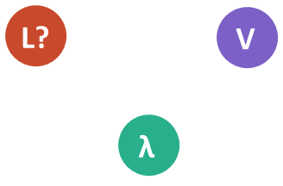

Causal Diversification: Conditional Effect Sizes
Does conditioning on one factor reveal a remaining effect of the other? [i.e., is there still a correlation?]
Does viviparity show an effect on rate after conditioning on clade?
Does clade show an effect on rate after conditioning on viviparity?
Viviparity
Viviparity
?
?
V|L ⊥ λ|L
λ|V ⊥ L
Notes:
… indicating they have substantial effect in this clade, (and that our DAG here should have a connection between Andes and rates)

Slide 67
Causal Diversification: Conditional Effect Sizes
Does conditioning on one factor reveal a remaining effect of the other? [i.e., is there still a correlation?]
Correlation weak!
Viviparity has little effect within Liolaemus
Correlation persists!
Viviparity alone can’t explain rate shift
Viviparity
Viviparity
V|L ⊥ λ|L
λ|V ⊥ L
Notes:
… indicating they have substantial effect in this clade, (and that our DAG here should have a connection between Andes and rates)

Slide 68


Causal Diversification: Conditional Effect Sizes
Does conditioning on one factor reveal a remaining effect of the other? [i.e., is there still a correlation?]
Do the Andes show an effect on rate after conditioning on clade?
Does clade show an effect on rate after conditioning on the Andes?
Andean Mountains
Andean Mountains
?
?
A|L ⊥ λ|L
λ|A ⊥ L
Notes:
… meaning that the andes alone COULD explain this rate shift.

Slide 69
Causal Diversification: Conditional Effect Sizes
Does conditioning on one factor reveal a remaining effect of the other? [i.e., is there still a correlation?]
Correlation strong!
Andes have substantial effect in Liolaemus
Correlation disappears!
Andes alone could explain this rate shift
Andean Mountains
Andean Mountains
A|L ⊥ λ|L
λ|A ⊥ L
Notes:
… meaning that the andes alone COULD explain this rate shift.

Slide 70
How often do you have a change in X and what’s the timescale of causation?
A singular event
A few events
A bunch of events
Continuous feedback

Slide 71
Granger causality
X₀
Y₀
X₁
X₂
Causes precede effects Past values of X improve prediction of Y
(beyond past values of Y alone)
Temporal predictive power, not true causation
Does a PCM model precedence?
Many PCMs do not test:
PGLS, PICs, mvBM etc.
Discrete traits: Cotinuous time Markov models (e.g. Pagel’s correlation test)
Continuous traits: Some OU & mvOU models
Y₁
Y₂
X₃
X₄
X₅
X₆
Y₃
Y₄
Y₅
Y₆
X_{t-1}
X_{t}
Y_{t-1}
Y_{t}

Slide 72
Markov models
(e.g. Pagel’s correlation)
Consider two binary characters (e.g. viviparity & cold env)
Independent model
Correlated model
Gain viviparity->
Gain viviparity->
Unequal rates depending on background state means correlation. In the hypothetical example,
q_[01 ->11] > q_[00->10]
q_[10 ->11] = q_[00->11]
Cold environment is a Granger cause of viviparity
(e.g. trait adaptation)
00
10
00
10
Gain cold env ->
Gain cold env ->
01
11
01
11

Slide 73
Markov models
(e.g. Pagel’s correlation)
Consider two binary characters (e.g. viviparity & cold env)
Independent model
Correlated model
Gain viviparity->
Gain viviparity->
In the hypothetical example,
q_[01 ->11] = q_[00->10]
q_[10 ->11] > q_[00->11]
Viviparity is a Granger cause of cold environment
(e.g. environmental filtering)
00
10
00
10
Gain cold env ->
Gain cold env ->
01
11
01
11

Slide 74
Ornstein-Uhlenbeck models
Univariate OU models - ouch, OUwie, etc.
OUBM model - slouch (Hansen et al. 2008)
Assumes X -> Y; estimates strength of causal effect (adaptation) in units proportional to time: ɑ

Slide 75


Slide 76


Slide 77


Slide 78


Ornstein-Uhlenbeck models
OUOU model - mvSLOUCH, layeranalyzer
Allows effects in both directions, can be compared using model selection
X_{t-1}
X_{t}
Y_{t-1}
Y_{t}

Slide 79

Fig 3. Bartoszek et al. 2023. Different causal models evaluated by different structures of the A matrix

Slide 80
Advanced methods in Causal Inference
Interventions & counterfactuals can be evaluated from DAGs
What would have happened, what will happen w/do()
What would the diversification rate for Liolaemus been if the Andes didn’t uplift?
What proportion of the elevated diversification rate of Liolaemus can be attributed to viviparity?
Evaluate the DAG with the estimated causal effects, but with values of causal factors set to specified values.

Slide 81
Do we have PCM “Amnesia”?
Once you commit to one causal explanation, you restrict all others.
PCM practice - We share trees, same clades
Different studies foreground different focal predictors
Background everything else (e.g. BM of residuals or hidden states) often despite previous studies
You can’t explain the same thing twice unless: 1) they are part of the same causal chain 2) one is spurious or misestimated. A plausible DAG may be wrong, but alternative DAGs are likely restricted to a similar distribution of explanatory factors. Committing to one causal scenario (e.g. the Andes causes diversification of lizards) can necessitate new explanations for other clades (why didn’t this Andean clade diversify?)
Can we build & synthesize, rather than background previous findings?

Slide 82

Case Study I

Slide 83



Miniature genomes in the Lentibulariaceae
Bladderworts (Utricularia)
Aquatic/terrestrial/epiphytic
Suction traps, no true roots
All genomes tiny
Smallest plant genomes ~61Mbp (Genlisea tuberosa) Fleischmann et al. 2014.
Corkscrew plants (Genlisea)
Terrestrial
Passive “lobster traps”
Some tiny genomes
Pinguicula
Genlisea
Utricularia
Butterworts (Pinguicula)
Terrestrial, outgroup
Passive flypaper traps
Normal genome sizes

Slide 84

Case Study II

Slide 85

Divergence & Diversification of the Honeyeaters (Meliphagidae)
~185 species mostly in Australia & New Guinea
Either nectarivorous, insectivorous, frugivorous, or a combination.

Slide 86
Case Study I
Group discussion 1.1 & 1.2 10 minutes
Full class discussion 1 5 minutes
Group discussion 1.3 5 minutes
Full class discussion 2 5 minutes
Group discussion 1.4 & 1.5 5 minutes
Full class discussion 3 10 minutes

Slide 87

Figure 4: Distribution of log10 genome sizes (a, c) and phylogenetic linear model residuals (d, f) between species carrying different COX mutations (a, d), or which are part of different OU-regimes (c, f). Gray points are genome sizes with added jitter, blue points are inferred expected values per group under the phylogenetic li

Slide 88


Slide 89
Case Study II
Group discussion 2.1 & 2.2 10 minutes
Full class discussion 1 5 minutes
Group discussion 2.3 10 minutes
Full class discussion 2 10 minutes
Group discussion 2.4 & 2.5 5 minutes

Slide 90

Figure 7: State dependent rates of Brownian motion for Meliphagidae body size (pPC1); a) rates for non-nectarivorous (0) and nectarivorous (1) lineages; b) rates for amalgamated states of nectarivory (0, 1) and BAMM rate regimes (A-D). Both analyses are based on 1000 stochastic mappings each,

Slide 91

Marki et al. analyses: TL;DR
Reconstruct nectarivory using ER model, 1000 stochastic mappings → origin around MRCA of honeyeaters and other clades
pPCA on four traits → PC1 explains 65.3% variation, reflecting overall size
mvBM model: rates of evolution of PC1, separate for nectarivorous vs not → higher rates for nectarivorous
BayesTraits/BAMM on PC1 to find shifts in rates of evolution → rate shift at base of honeyeaters, plus 1-2 smaller clades

Slide 92
Schedule
8:30 - 9:30 Lecture
9:30 - 9:45 Questions/Discussion
9:45 -10:00 Group building/introductions
10:00 - 10:30 Coffee break
10:30 - 11:00 Case Study I
11:00 - 11:30 Case Study II
11:30 - 12:00 Questions/Discussion
pollev.com/josefuyeda941

Slide 93
Why Causal inference?
Confounders & latent factors/OVB
Lack of experiments / observational data
🡪 we KNOW this, but CI tells us HOW to deal with it
Causal structure, i.e., include process that generated data
Assumptions, biases, direct vs indirect effects
Unknown causal relations mess up prediction
Description vs intervention
THE CAUSES ARE NOT IN THE DATA
🡪 check McElreath’s rethinking class for more and better explanations
🡪 ingoring philosophical differences for now (test vs. estimate, OWLS, etc.)

Slide 94
DAGs

Slide 95
DAGs: Elemental Confounds
Fork
Example: Marriage rate & divorce (& age more young ppl)
Assoc. Danger: missing confounder
Pipe
Example: Anti-fungal treatment & plant growth
Assoc. Danger: post-treatment bias (block path of effect)
Collider
Example: Grant apps (trustworthy, newsworthy, funded) or actors (talented, beautiful, famous), restaurants (location, food, survival)
Assoc. Danger: sampling-bias, bad (endogenous) controls
Descendant (‘Parasite’)
Example: Everywhere (proxies, errors, …)
Assoc. Danger: proxies it’s like conditioning on parent node!
🡪 larger DAGS contain these, there’s rules for how to read them [skip?]
Also total vs direct effect etc.

Slide 96
Inference vs DAG testing (d-sep)
Fork example [overhaul to use better one]

Slide 97
Applying to Phylogenetics
Felsenstein & DAG
🡪 start with this?
🡪 can be wrong?
🡪 add shift!
PPA
Show how it works and how it fails?
Show more on how we do it or go straight to Examples?

Slide 98
Ѱ
X ⊥ Ѱ
λ_{X} = 0, means that X is consistent with independence of ancestry
Z
Y|X ⊥ Ѱ
λ_{Y|X} > 0, means that the residual variation IS correlated with ancestry
X
Y
λ_{Y|X} > 0
λ_{X} = 0
λ_{Y} > 0
This means that the path from an open backdoor phylogenetic confounder Z is unlikely!

Slide 100
Clade
Deviation from clade mean X
Deviation from clade mean Y
Y
X
Clade
Clade
Clade mean X
Clade mean X
Y
Y
Deviation from clade mean X
X
Change in X
Change in Y
Acceleration of change in X
Acceleration of change in Y
Rate of other clade-level changes

Slide 101
Collider: common effect
Z
X
Y
Example:
restaurant location and quality
actor looks and talent
grant newsworthy vs trustworthy
exerise, diet, and hospitalisation
→ Sampling bias / bad (endogenous) controls

Slide 102
Mediators/pipes
Don’t adjust for mediators/pipes!
Genetics
Smoking
Lung cancer

Slide 103

d-separation: testing the DAG
Z
X
Y
Z
X
Y
X
Y

Slide 104
Mediators/pipes
Don’t adjust for mediators/pipes!
e.g. regression
L ~ B + S
Blood pressure
Blocks causal path between S & L
Coefficient estimates only partial causal effect of S -> L
Smoking
Lung cancer

Slide 105
Danger: Colliders
Conditioning on colliders creates spurious correlations
Assume S -> L = 0
S -> H > 0
L -> H >0
Pop in H will be enriched for both S & L, result in estimation of S -> L > 0
e.g. regression
L ~ H + S
Hospitalization
Opens backdoor path between S and L
Coefficient estimates spurious effect of S -> L
Smoking
Lung cancer

Slide 106
Case Studies
Utricularia
Data/Residuals as d-sep outliers
Exploratory for better fit
Alternative explanations to explore further
🡪 check with Rosana about COX and epistatic effects?
Meliphagidae
Nectarivory-BS-evo only by 1 shift?
Condition on background rate shifts
Latent effect higher, nectar effect negative (or secondary nectarivory higher?)
🡪 Fels on steroids

